Slide 1




Innovate to Transform
08 - 11 October, 2025 | Yashobhoomi, New Delhi
1st meeting for Stakeholders Committee | 4th August, 2025

Slide 2
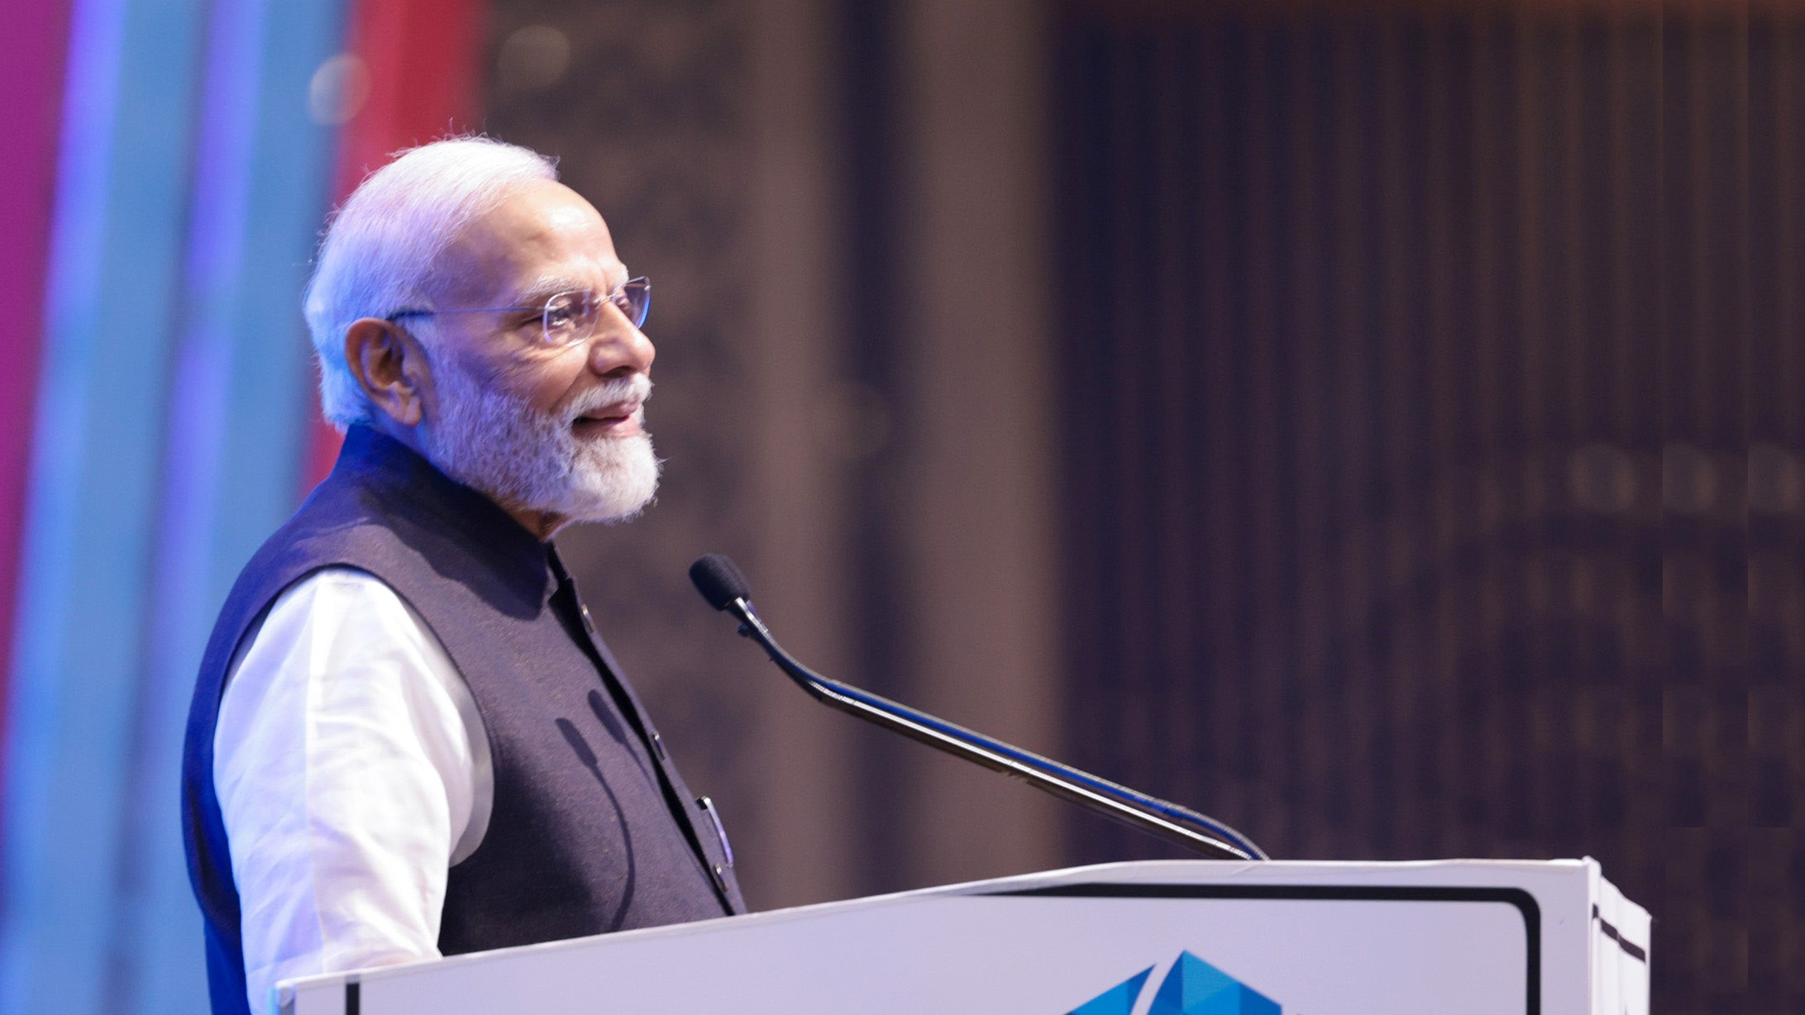
“Bharat has democratized digital technology.”
SHRI NARENDRA MODI
Hon’ble PM at the inauguration of IMC 2024

Slide 3
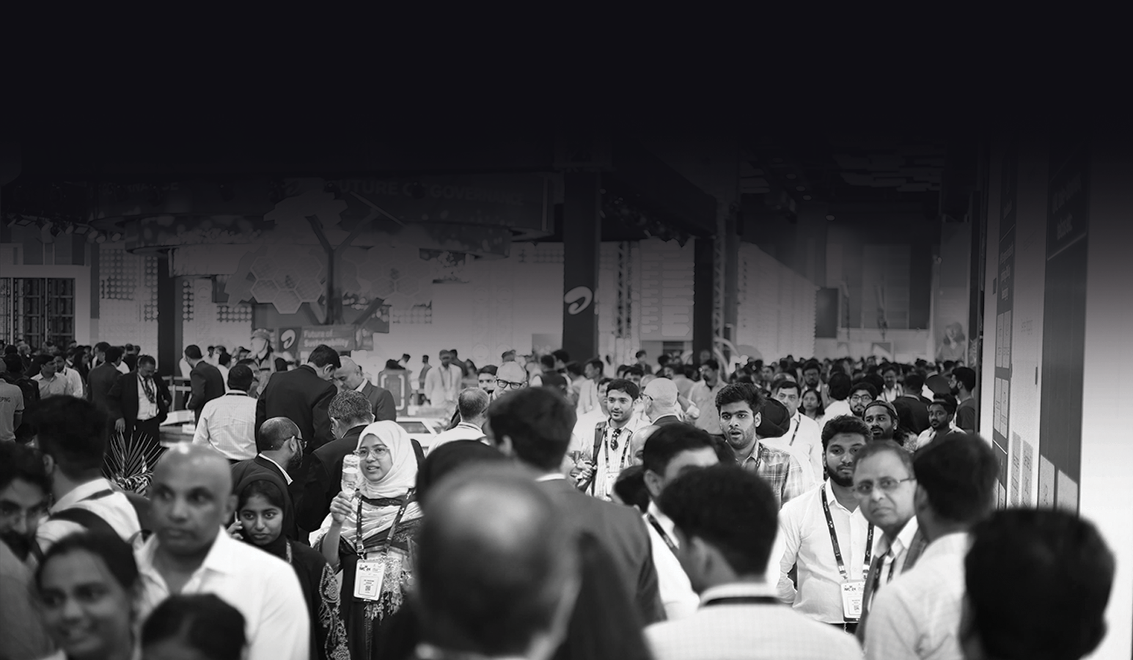
IMC 2025
Venue:
Yashobhoomi,
New Delhi
Expo Dates:
8-11 October, 2025
Theme:
Innovate to
Transform
Exhibition
Halls:
Hall 1 & 2
Build up Dates:
3-7 October, 2025

Slide 4
Reach, Resonance &
(1/2)
Growth
150k+
Attendees
120+
Countries
42ksqm+
Exhibition Area
400+
Exhibitors
1600+
Technology Use-cases
500+
Startups

Slide 5
Reach, Resonance &
(2/2)
Growth
300+
Investors, Incubators,
Accelerators, VCs
600+
1-2-1 Investor Meetings
800+
Thought Leaders
100+
Sessions
30+
Ministries

Slide 6

List of Ministries/ PSUs that participated in exhibition in IMC 2024
SL No | Ministries
1 | Railway Board
2 | Department of Science & Technology (DST)
3 | Indian Space Research Organisation (ISRO)
4 | Ministry of Electronics and Information Technology (MeitY) / STPI
5 | Central Mine Planning and Design Institute (CMPDI)
7 | Assam Electronics Development Corporation Ltd. (AMTRON)
8 | Ministry of Heavy Industries (MHI)
9 | Indian Council of Agricultural Research (ICAR)
10 | National Highways Authority of India (NHAI)
11 | Ministry of Power
12 | Ministry of Fisheries
13 | Ministry of Mines
16 | Powergrid
17 | RailTel
18 | BSNL
19 | Centre for Development of Telematics (C-DOT)
20 | Telecommunications Consultants India Limited (TCIL)

Slide 7
New Ideas for
IMC 2025
Startup World Cup
India
Networking
Mixers
Country Pavilions :
Japan, UK, Canada,
Russia
Digital Media Partnership with Storyboard18 – Network18 Group
Open API
Hackathon

Slide 8


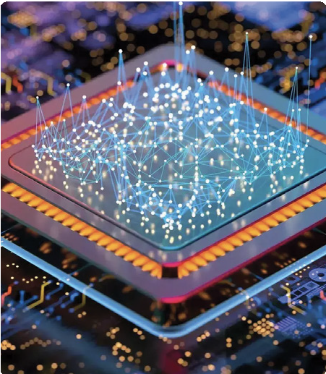






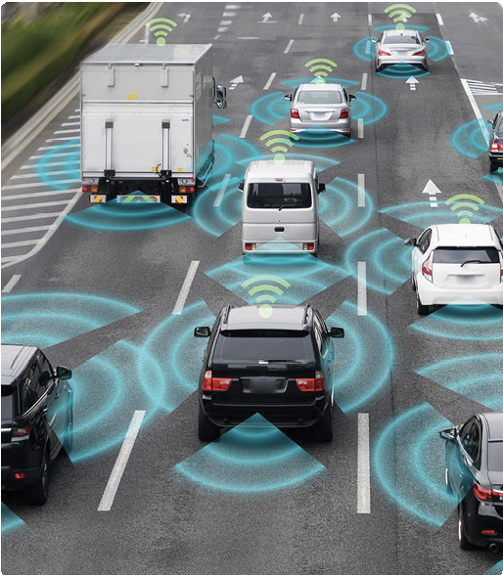


The Frontiers of Innovation
5G & 6G
ARTIFICIAL INTELLIGENCE
SEMICONDUCTORS
ELECTRONICS MANUFACTURING
SATELLITE COMMUNICATIONS
SECURITY
QUANTUM COMPUTING
DEEP TECH
ENTERPRISE TRANSFORMATION
SMART MOBILITY
INDUSTRY 4.0
CLEAN TECH

Slide 9
Stakeholders and Participants
Global Participation from varied spaces including::
Government
  Ministries
  State
  PSUs
Industry
  TSPs /ISPs
  Chipset companies
  Manufacturers
  OEMs
  Tech. companies
  MEMEs & SMEs
  System Integrators
  Industry Associations
Start-ups
01
03
04
Mentors
Angel Investors
VCs & PEs
02
Academia
R&D institutes
Education Institutes
Students
Country Partners
05
Discussion with following:
Japan
UK
Canada
Austria
Russia
to participate as country partners

Slide 10
Key Conference Highlights
20 Keynotes
80+ Panel Discussions
18 Industry Round Tables
2 CXO Roundtables
State IT Ministers & Sec
08 Cabinet Ministers
10 Chief Ministers
800+ Speakers
International delegates from 120+ Countries
10k+ CXOs
25k+ Industry Delegates
International 6G Summit
Artificial Intelligence Summit
Quantum Summit
Cyber Security Summit
State IT ministers & Sec Round Table
Industry CEO Round Table
Industry CTO Round Table
FSC - TSPs CTO and Sec (T)
5G use cases
International Buyer meet
Startup World Cup – India
Open API Hackathon
AI for good Summit
Investor & Mentor Networking
IMC Awards

Slide 11


IMC Aspire 2025:
Aspire is IMC’s dedicated platform for startups to showcase innovation, connect with investors, and scale globally. With 450+ prime selected startups from across diverse tech domains, Aspire is where bold ideas meet real opportunities.
Key Highlights at IMC Aspire 2025:
Startup World Cup – India
GSMA Open API Hackathon
In partnership with Pegasus Tech Ventures
$1 Million Grand Prize at Global Finals (San Francisco)
A launchpad for Indian startups to connect with global investors & mentors
Driving India’s leadership in deep-tech and digital innovation
Powered by the GSMA Open Gateway initiative
Build with live telecom network APIs
Create solutions in fintech, mobility, logistics, and more
Empowering developers to build the next generation of digital services

Slide 12
Requests to the Ministries for IMC 2025
Ministry of Electronics and Information Technology (MeitY)
Department of Science & Technology (DST)
Ministry of External Affairs
Ministry of Railways
Ministry of Defence (MoD)
Ministry of Education
Department of Health and Family Welfare (DoH&FW)
Department of Agriculture & Farmers Welfare (DA&FW)
Ministry of Housing & Urban Affairs (MoHUA)
Ministry of Power (MoP)
Ministry of Road Transport and Highway (MoRTH)
Department of Expenditure (DoE), Ministry of Finance
Department of Space (DoS)
Ministry of Information & Broadcasting (MIB)
Ministry of New & Renewable Energy (MNRE)
Showcase technology (5G, AI, IoT, Deep Tech, Satcom, Quantum, Cyber security, etc.) application in respective exhibition area
Free Exhibition Space: 20 Sqm each (to be distributed among 10 Ministries)
IMC will offer Discounted Rate for Additional Bare space: INR 20,200 + GST (INR 23,836)
Construction Cost: to be borne by respective ministries
Nodal officer from every ministry
Key updates in upcoming slides

Slide 13
Requests to the Ministries for IMC 2025
Department of Science & Technology, Ministry Of Science And Technology
Ministry of Ports, Shipping and Waterways
Logo support
Confirmation on Booth space: 400 sqm Approx. (including startups on Quantum and Cyber physical systems)
Detailed program for Quantum and Cyber physical System Summit
Blocking Calendar of Hon’ble DST Secretary as a Keynote Speaker in Quantum Summit.
2-hour session of DST Secretary on Vice Chancellors’ Roundtable Conference on Strategic Utilization of the GOI ₹1 Lakh Crore Anusandhan R&D Fund, on 9th Oct; 4-6 pm;
Participation in following Panel discussions from Senior experts:
  Digital Infrastructure
  Industry 4.0
  5G Use cases

Slide 14
Requests to the Ministries for IMC 2025
Ministry Of Electronics & Information Technology
Presence of Leadership of MeiTY for AI Summits on 9 October 2025
Logo support of MeitY, Digital India, India AI Mission, STPI
Booth space: 416 sqm (MeitY + STPI):
Proposed Panels for AI Summits:
  Democratizing Intelligence: Building India’s AI Infrastructure
  Rewriting the Rules: Gen AI and the Future of Enterprises
  Building Bharat’s Future with Applied AI
  The Future of AI Research: Open, Interdisciplinary, Global" / AI Research: Open by Design, Driven by Collaboration
  Intelligent, Adaptive, Secure: The Rise of Autonomous Networks/AI at the Core: The Road to Fully Autonomous Networks
  Responsible AI: India’s Role in Global Governance and Societal Impact
  AI and the Future of Work: Skills, Jobs, and Workforce 2.0“
  India’s AI Moment: From Global User to Global Shaper

Slide 15
Request to Ministries for IMC 2025
Ministry Of Information & Broadcasting
Ministry of Education/Ministry of Health/ Ministry of Agriculture
Extend invitation to following Hon’ble Ministers:
Shri Jagat Prakash Nadda
Shri Shivraj Singh Chouhan
Shri Dharmendra Pradhan
Participation in following Panel discussions from Senior experts:
  5G Use case labs
  Edge AI: Unlocking Value from Farms to Factories
Booth space: 100 sqm
Detailed program for Broadcasting Summit
Ministry Of Railways
Request for exhibition space to showcase smart mobility applications
Ministry of New and Renewable Energy
Participation in following Panel discussions from Senior experts:
  The circular leap from e-waste to e-wealth
  Green Telecom: Green Premium or Green savings

Slide 16
Request to Ministries for IMC 2025
Department of Space (DoS)
Ministry of Finance
Panel Discussion suggested topics based on meeting with Chairman IN-SPACe:
  The future of Satcom in India
  Enhancing capacity and demand of Satcom applications & services
  Next-gen Satcom technologies
  Satellite applications for rural connectivity
Relevant key panelists will be finalized in association with IN-SPACe expertise.
We propose the summit to be inaugurated by senior leadership from both Government and industry, including Hon’ble Minister of Communications Shri Jyotiraditya Scindia, Dr. Jitendra Singh (MoS, Space), Dr. Pawan Goenka (Chairman, IN-SPACe), Dr. V. Narayanan (Chairman, ISRO) and Secretary (Telecom)
Closure of dedicated Space-Tech Pavilion (100 Sqm).
Extend invitation to Hon’ble Minister of Finance Smt. Nirmala Sitharaman
Bytes to Billions: Financing Bharat’s Digital Entrepreneurs
Participation of Powergrid & Powertel
VISA issuance for foreign delegates –Political Clearance
Spreading awareness on IMC from Indian Embassies/ Missions abroad
Ministry of Power (MoP)
Ministry of External Affairs/ Home Affairs

Slide 17
Request to Ministries for IMC 2025
Ministry of Defence
Ministry of Road transport & Highways
Need support to close participation of startups from The Innovations for Defence Excellence (iDEX) program
Masterclass for startups on doing business with Defence industry at Aspire stage
Participation from BEL at IMC 2025
Invitation on all three Defence chiefs & important members of defence staff
Invitation to Hon’ble Minister of Road Transport & Highways
Participation in following Panel discussions from Senior experts:
  Digital Infrastructure First: Bridging AI Potential and Rural Progress
Ministry of Rural Development
Participation in following Panel discussions from Senior experts:
  Bytes to Billions: Financing Bharat’s Digital Entrepreneurs
Ministry of Housing and Urban Affairs
Participation in following Panel discussions from Senior experts:
  Digital Infrastructure First: Bridging AI Potential and Rural Progress
Invitation to Smart City CEOs across India

Slide 18

Innovate to Transform
^{J}EXHIB^{O}ITION ^{I}I C^{N}ONCLAV^{U}E I AW^{S}ARDS
www.indiamobilecongress.com info@indiamobilecongress.com

